Slide 1
DATABASE MANAGEMENT FOR ONLINE ORDERING
Enhancing Operational Efficiency and Customer Experience

Slide 2
Introduction
Objective: Highlight the goal of developing a comprehensive database management system to support the client's online ordering platform.
Problem Statement: Managing member data, analyzing customer behaviors, and coordinating marketing activities pose challenges for the online ordering startup. Without a centralized database system, inefficiencies arise in order processing and marketing strategies, hindering data accuracy and customer experience. Developing a tailored database solution is crucial to enhance operational efficiency and customer satisfaction.
Key Points:
- Enhancing member management operations.
- Analyzing customer behaviors and preferences.
- Facilitating marketing activities and menu management.

Slide 3

Building a Customer-Centric Database
Key Objectives:
Track & Analyze: Deeply understand customer behavior and preferences.
Personalize Experiences: Deliver tailored services and offerings.
Localize: Customize offerings based on unique geographic needs.
Guiding Principles:
Unified View: Seamlessly integrate data across all touchpoints.
Data-Driven Decisions: Prioritize accuracy and integrity for reliable insights.
Scalability: Adapt to future growth and expansion effortlessly.
Security First: Protect sensitive customer data with robust protocols.
Components:
Member Management: Track member information, preferences, and orders to personalize offerings and enhance loyalty programs.
Order Management: Capture detailed order data, including geographic location, to analyze regional preferences and optimize inventory.
Marketing Activities: Track marketing campaigns, their effectiveness, and impact on customer engagement and orders.
Menu & Staffing Management: Ensure up-to-date menu levels and efficient staffing levels based on real-time demand and forecasts.

Slide 4

Powering Growth with a Customer-Centric Database
Key Features:
Understand Needs: Analyze preferences for personalized experiences.
Comprehensive Data: Manage member, order, and marketing data seamlessly.
Operational Efficiency: Optimize staffing, inventory, and quality control.
Marketing Analysis: Target campaigns, track effectiveness, and boost engagement.
Real-Time Updates: Ensure accurate information and responsive decisions.
Decision-Making Support: Leverage data insights for strategic growth.
Business Rules:
One Customer, One Voice: Streamline experience with unique identifiers.
Flexible Cancellations: Empower choice within defined timelines.
Targeted Outreach: Deliver relevant campaigns, drive action.
Honest Feedback: Encourage ratings for continuous improvement.
Measurable Impact: Track engagement and optimize marketing efforts.
Live Menu Availability: Maintain trust with accurate inventory updates.
Benefits:
Enhanced customer satisfaction and loyalty.
Increased operational efficiency and profitability.
Data-driven marketing for smarter decisions.
Competitive advantage in a dynamic market.
Next Steps:
Schedule a demo to explore the platform in action.
Partner with us to build your customer-centric future.

Slide 5
Business Needs
Client Background:
Client Requirements:
Member Management: Maintain current member order practices and conduct behavioral analysis.
Online Ordering Startup: Covers 30 restaurants across 6 cities.
Services: Facilitates to-go meal orders from participating restaurants via an online platform.
Member Management Team: Responsible for capturing data on members and their orders.
Objective: Improve member management operations and provide data for marketing analysis.
Geographical Variation: Customer preferences may vary based on location (e.g., climate-driven food preferences).
Geographical Consideration: Adapt marketing strategies based on regional preferences.
Data Capture: Collect information on member behaviors and preferences for analysis.
Marketing Activities: Track and analyze marketing initiatives for effectiveness.
Menu Offerings: Manage and update menu offerings based on customer demand.
Staffing Requirements: Maintain records of employee information for staffing management.

Slide 6
Database Overview and Business Rules
Database Entities:
- Customer Information: CustomerID, Name, Email, Phone, Address, City
- Order Details: OrderID, CustomerID, OrderDate, TotalAmount
- Restaurant Information: RestaurantID, Name, Address, City
- Menu Items: ItemID, RestaurantID, Name, Price, MealType, ItemType
- Marketing Activities: ActivityID, RestaurantID, Date, Description, TargetAudience
- Employee Information: EmployeeID, RestaurantID, Name, DOB, DateOfJoining
Business Rules:
- Each entity has a unique identifier for efficient referencing.
- Mandatory customer details ensure accurate order processing.
- Orders are linked to valid customers and restaurants for data integrity.
- Menu items are associated with specific restaurants for accurate menu management.
- Marketing activities are linked to relevant restaurants for effective targeting.
- Accurate employee information is recorded for administrative purposes and compliance.

Slide 7
Entity Attributes:
Customer Information: CustomerID (Primary Key), Name, Email, Phone, Address, City
Order Details: OrderID (Primary Key), CustomerID (Foreign Key), OrderDate, TotalAmount
Restaurant Information: RestaurantID (Primary Key), RestaurantName, Address, City
Menu Items: ItemID (Primary Key), RestaurantID (Foreign Key), Name, Price, MealType, ItemType
Marketing Activities: ActivityID (Primary Key), RestaurantID (Foreign Key), Date, Description, TargetAudience
Employee Information: EmployeeID (Primary Key), RestaurantID (Foreign Key), Name, DOB (Date of Birth), DateOfJoining

Slide 8
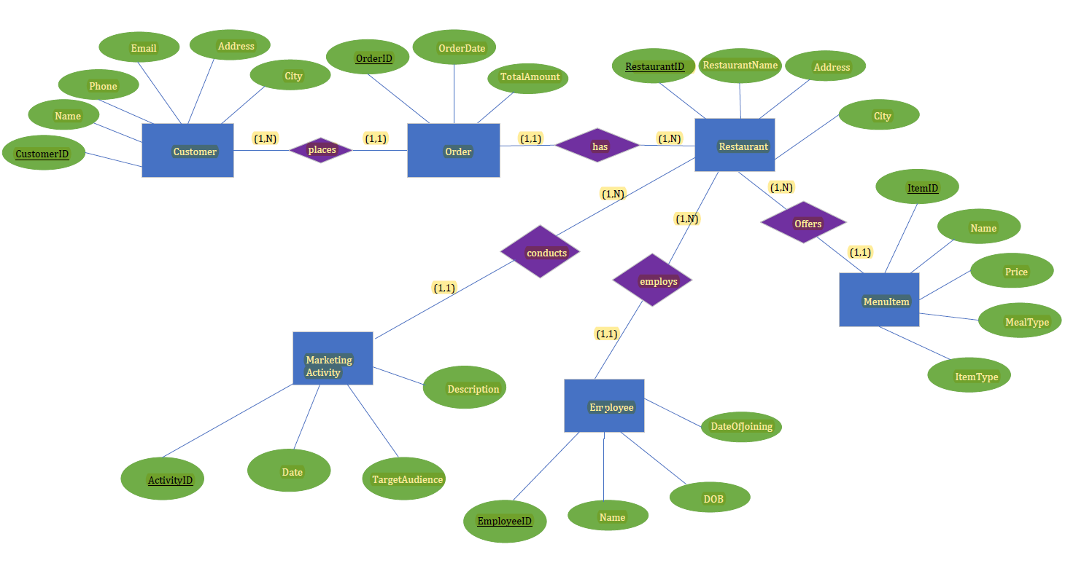
Conceptual Model

Slide 9
Database Entities Overview & Transformation Rules
Customer Table:
CustomerID (PK, int, not null)
Name (varchar, not null)
Email (varchar, not null)
Phone (varchar, null)
Address (varchar, not null)
City (varchar, not null)
Order Table:
OrderID (PK, int, not null)
CustomerID (FK, int, not null)
RestaurantID (FK, int, not null)
OrderDate (datetime, not null)
TotalAmount (decimal (10,2), not null)
Restaurant Table:
RestaurantID (PK, int, not null)
RestaurantName (varchar, not null)
Address (varchar, not null)
City (varchar, not null)
MenuItem Table:
ItemID (PK, int, not null)
RestaurantID (FK, int, not null)
Name (varchar, not null)
Price (decimal (10,2), not null)
MealType (varchar, not null)
ItemType (varchar, not null)
Marketing Activity Table:
ActivityID (PK, int, not null)
EmployeeID (PK, int, not null)
RestaurantID (FK, int, not null)
Transformation Rules:
Entities to Tables
RestaurantID (FK, int, not null)
Date (date, not null)
Description (text, not null)
TargetAudience (varchar, not null)
Name (varchar, not null)
DOB (date, not null)
DateOfJoining (date, not null)
Attributes to Columns
Primary Keys Designation
Foreign Keys Establishment
Data Types Assignment
Constraint Enforcement (e.g., not null)

Slide 10
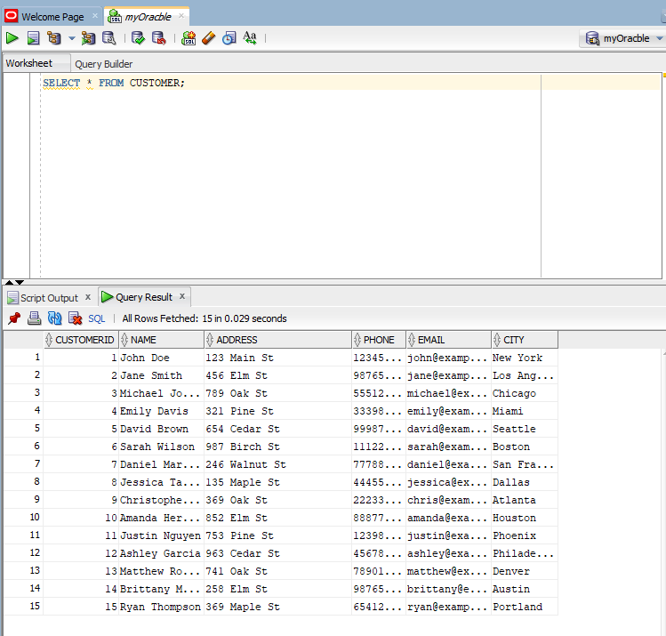
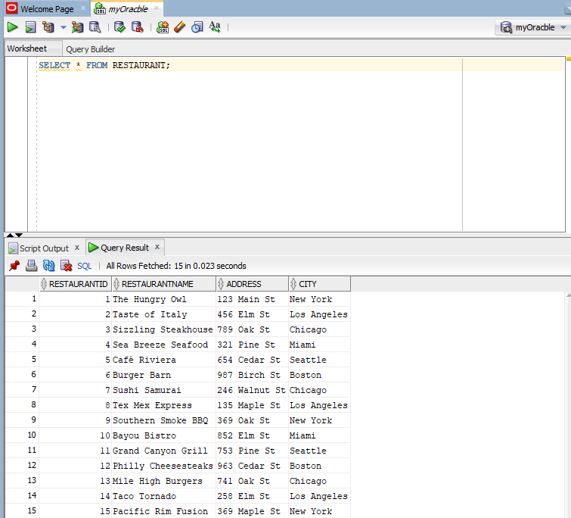
Sample Queries showing Data from Tables
Query 1: Show Data from Customer Table
Query 2: Show Data from Restaurant Table

Slide 11

Non-trivial Queries
Query 1: Average Total Amount Spent per Order for Each Restaurant
Importance: Understand customer purchasing behaviors and revenue patterns for pricing strategies and service enhancements.
Query 2: Retrieve Customers Who Have Placed Orders > $50
Importance: Identify high-value customers, analyze purchasing patterns, and optimize marketing strategies.
Query 3: Employee Names and Employment Duration in Each Restaurant
Importance: Monitor workforce longevity, assess retention rates, and make strategic HR decisions.
Query 4: Total Number of Orders Placed by Each Customer
Importance: Analyze customer engagement, identify loyal customers, and tailor marketing strategies.
Query 5: Latest Marketing Activities per Restaurant
Importance: Assess recent promotional efforts, inform future marketing strategies, and enhance customer engagement.
Query 6: Customer Diversity: Number of Restaurants Ordered From
Importance: Understand customer behavior, enable targeted marketing efforts, and enhance loyalty.
Query 7: Total Revenue Generated by Each Restaurant in Last Quarter
Importance: Analyze revenue performance, identify top-performing restaurants, and optimize strategies.
Query 8: Ensuring Positive Total Amounts in Orders (Integrity Constraint)
Importance: Maintain data consistency, prevent invalid entries, and ensure accurate financial records.
Query 9: Identify Restaurants with High Employee Turnover Rates
Importance: Address HR issues, improve employee satisfaction, and reduce recruitment costs.
Query 10: Analysis of Popular Menu Items by Restaurant
Importance: Optimize inventory, pricing, and marketing strategies to enhance customer satisfaction and drive revenue growth.

Slide 12
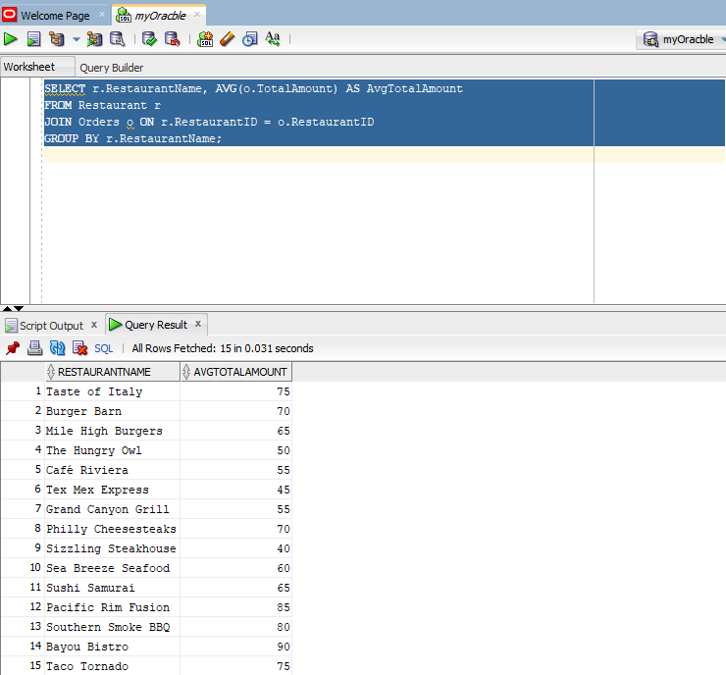
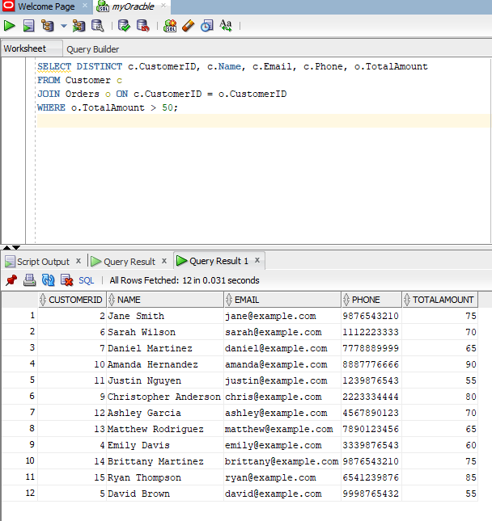
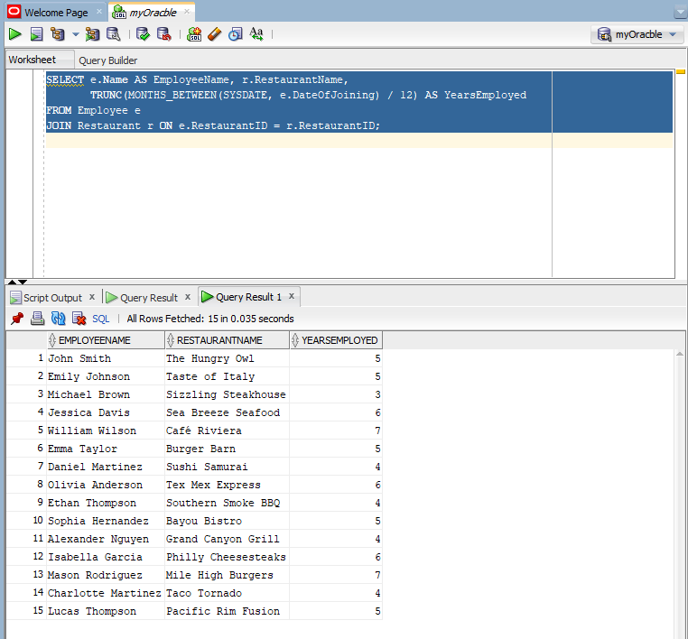
Sample Non-trivial Queries Output
Query 1
Query 2
Query 3

Slide 13
Drive Growth & Delight Customers with Data-Driven Insights
Uncover
Uncover Profitable Opportunities:
Customer Preferences: Tailor inventory and marketing based on top menu items by region.
Location-Based Targeting: Boost ROI by focusing campaigns on high-spending areas.
Marketing ROI Analysis: Optimize future efforts for maximum impact.
Enhance
Enhance Efficiency & Engagement:
Optimized Staffing: Ensure ideal staff levels based on real-time demand.
Faster Customer Service: Access complete order details instantly.
Smarter Inventory Management: Prevent stockouts and maintain availability.

Slide 14
Powering Performance with Real-Time Updates
Quality Control: Track customer feedback and ratings to drive continuous improvement and uphold high standards.
Menu Agility: Update menu availability instantly based on demand and specials, ensuring customer satisfaction.
Informed Decisions: Gain holistic insights into sales, performance, and trends for strategic planning and growth.
Data-Driven Decisions: Leverage analytics to optimize pricing, expand into new markets, and refine your competitive edge.
Future-Proof Solution: Scale with your business to ensure ongoing success and customer engagement.
Next steps:
Schedule a demo to experience the platform in action.
Partner with us to build your data-driven future.

Slide 15
Real-World Significance of CRM Database
Customer Segmentation Data:
Categorizes customers based on demographics and preferences for targeted promotions, enhancing marketing efforts and sales.
Order Preferences and History:
Tracks individual order history to offer personalized recommendations, improving customer experience and encouraging repeat purchases.
Feedback and Reviews:
Provides insights into customer satisfaction levels and areas for improvement, fostering brand loyalty and reputation management.
Loyalty Program Management:
Incentivizes repeat purchases through a loyalty program, identifying loyal customers for tailored offers and increased lifetime value.
Integration with Social Media:
Facilitates direct communication with customers, strengthens brand loyalty, and enhances visibility, driving overall customer engagement and satisfaction.

Slide 16
Your Competitive Edge Starts Here!!
Empower Your Startup to Thrive:
Centralized Data: Gain unified insights across all aspects of your business.
Operational Efficiency: Simplify workflows and maximize resource utilization.
Strategic Insights: Leverage data to inform smart decisions and drive growth.
Superior Customer Experience:
Personalization: Build loyalty with tailored offers and recommendations.
Real-Time Updates: Ensure product availability and maintain trust.
Quality Control: Continuously improve based on customer feedback.
Future-Proof Foundation:
Scalable Solution: Adapt and grow seamlessly with your business needs.
Market Responsiveness: Stay ahead of trends and customer demands.
Sustainable Success: Deliver operational excellence and exceptional service.
Partner with us to unlock your data-driven future!!

Slide 17
THANK YOU
Group No. 2
MD Kamruzzaman Kamrul
Manoj Potnuru
Gaurav Mishra
Purvi Bharani
Kelly Duong

